Slide 1
Implementation of HIV Pre-exposure Prophylaxis (ImPrEP) for men who have sex with men and transgender women at high risk for HIV infection: A demonstration project in the context of combination prevention in Brazil, Mexico and Peru
Hamid Vega, M.D., M.Sc.
Condesa & Condesa-Iztapalapa Specialized Clinics
United Nations Found Population

Slide 2
ImPrEP – Mex / Background
This is the first time Mexico participates in a nationwide PrEP project
We have a National Guideline for HIV Treatment which is updated annually
There are HIV prevention manuals which serve as reference documents in the subject matter
The National HIV Programme has been providing annual funding to NGOs since 2006 to conduct HIV prevention activities for those most affected
For the last couple of years in Mexico, HIV diagnosis has been central in anchoring prevention efforts around the needs of the most affected population groups

Slide 3
ImPrEP-Mex / Members
Center for HIV/STI Prevention & Control / Clínicas Especializadas Condesa, Mexico City
Andrea González
Florentino Badial
Steven Diaz
Galileo Vargas
Israel Macías
Verónica Ruiz
United Nations Population Fund (UNFPA), Mexico
Arie Hoekman
Adriana Martínez
National Centre for HIV/Prevention & Control
Patricia Uribe
Carlos Magis
Jalisco HIV/STI Prevention Program
Ariel Campos
Civil Organizations
Inspira
Mexico Vivo
Checos
SETAC
National Institute of Psychiatry “Ramón de la Fuente”
Rebeca Robles
National Institute of Medical Sciences and Nutrition “Salvador Zubirán”
Juan Sierra
National Institute of Pubic Health
Hugo López-Gatell
René Leyva
Alejandra Cortés
Priscilla Espinoza
Sergio Bautista
Cortesy: HLGR

Slide 4
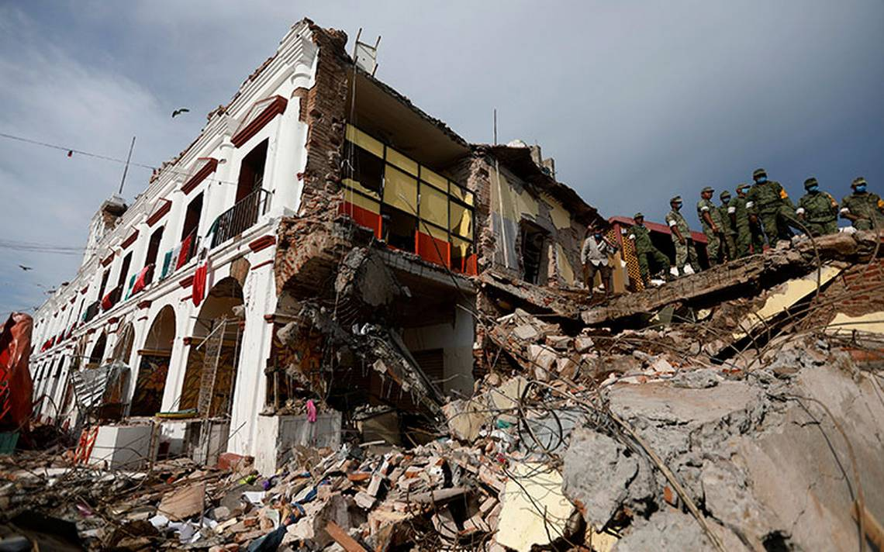
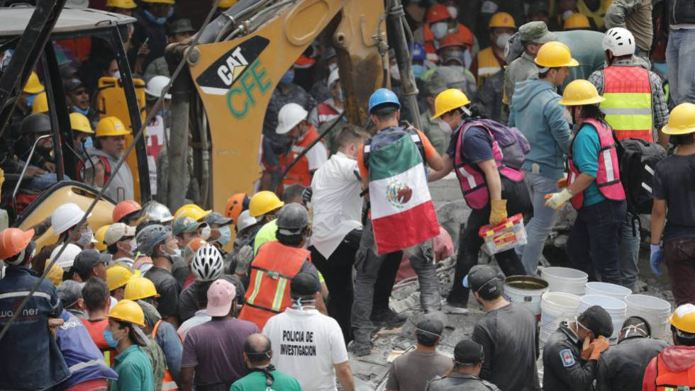
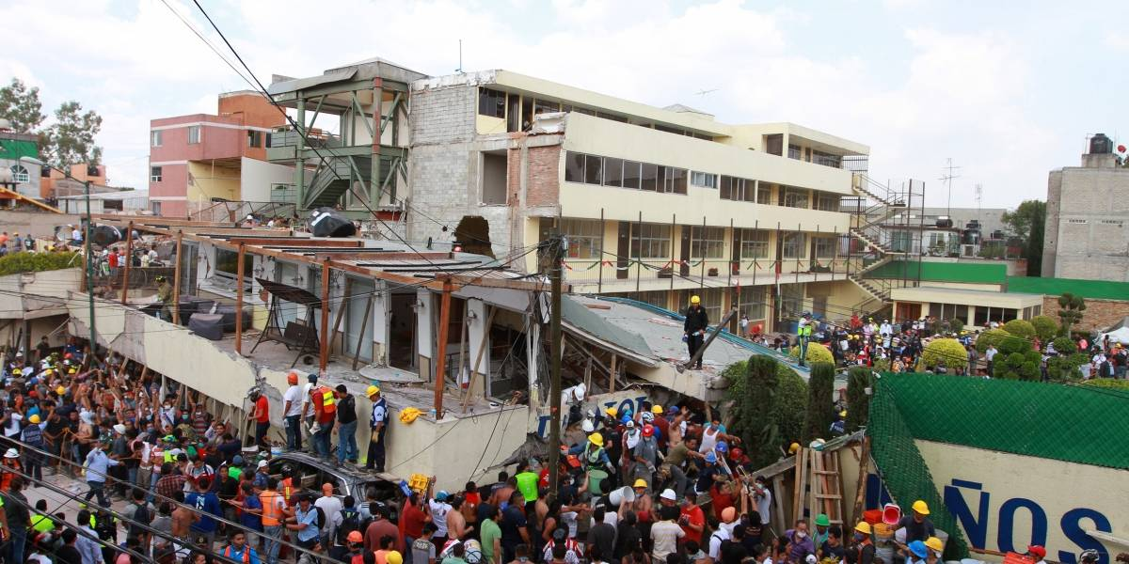
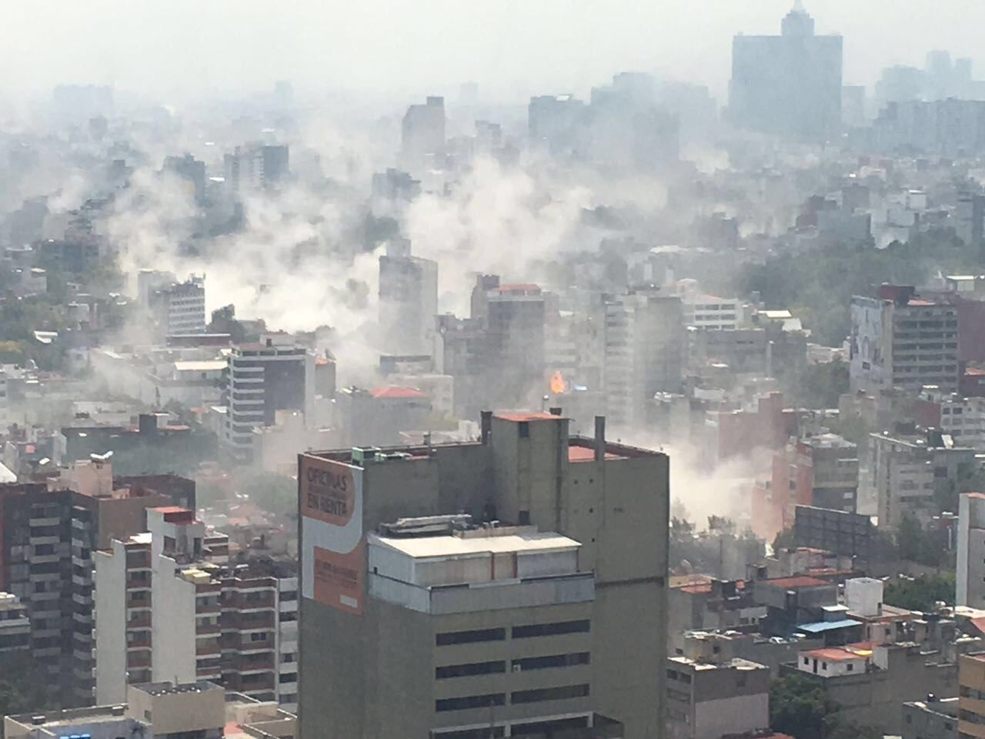
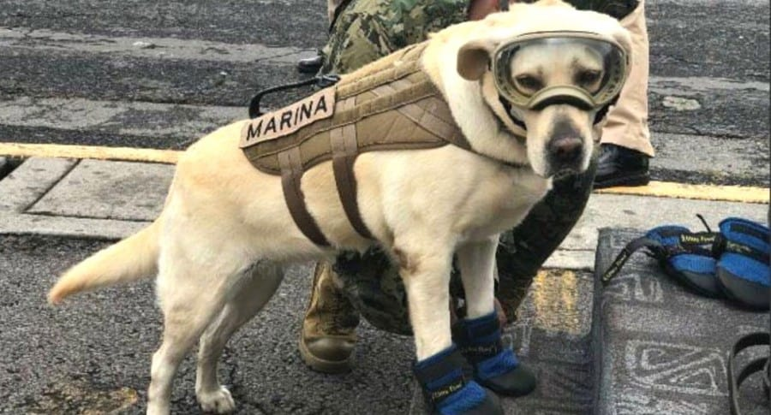
Juchitan, Oaxaca
ImPrEP-Mex
CDMX
Kinder garden, CDMX
CDMX, Sep 19th, 14:30 h
Rescuer dog, Frida

Slide 5
ImPrEP – Mex / Goals
To create a National Public policy for HIV prevention
Develop a National Prevention guide
Widen the range of prevention services available in the country
Strengthen community level prevention services offered through NGOs
Promote STI prevention and treatment among the most affected groups
Promote a change in the social norm of risk perception among most affected groups thus increasing prevention services utilization
Assign resources in the national and state budgets for expanded HIV prevention services

Slide 6
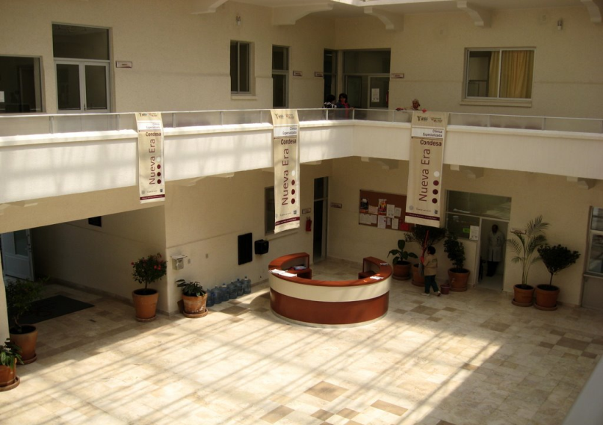
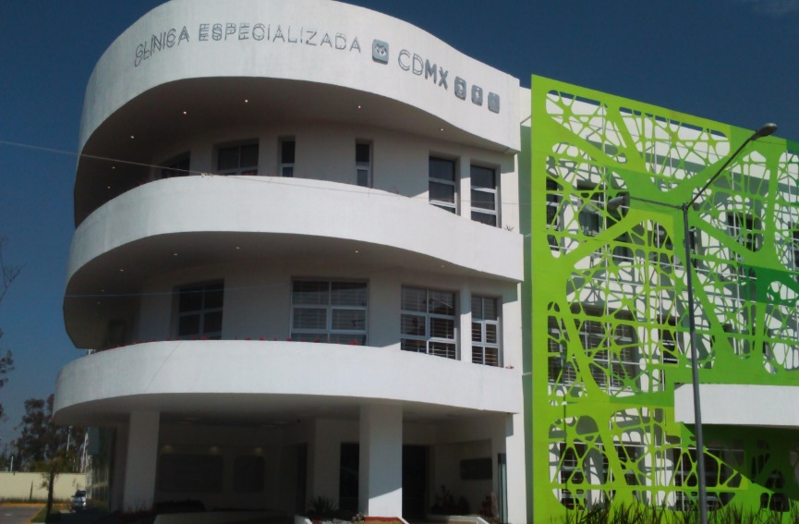
Clínica Especializada Condesa
Clínica Especializada Condesa-Iztapalapa
www.condesadf.mx

